Slide 1
IS THERE A RIGHT WAY TO TEACH READING?
Improving Reading Proficiency for Students with Disabilities

Slide 2
About Your Presenter
I am a Senior Staff Attorney at Disability Rights Florida
I am licensed to practice law in Florida and admitted to all courts, both federal and state within Florida, including the 11th Circuit Court of Appeals.
I represent clients in administrative hearings through the Division of Administrative Hearings (DOAH).
I am the mother of a special needs child.
Prior to becoming an attorney, I was an educator. As a teacher, my expertise was in literacy skills development.

Slide 3
Disability Rights Florida

Slide 4
Disability Rights Florida
Funding, responsibility, and authority under nine federal programs to protect and advocate for the rights of Floridians with disabilities.
A not-for-profit corporation since 1987.
Offices in Tallahassee, Gainesville, Tampa, and Hollywood
Satellite offices in several other communities

Slide 5
Our Mission
To advance the quality of life, dignity, equality, self-determination, and freedom of choice of persons with disabilities through collaboration, education, advocacy, as well as legal and legislative strategies.

Slide 6
A Sobering Reality
On average, only 36% of Florida’s 12th grade students are graduating as proficient readers. The national average is 37%.
By third grade, all subject matters require proficient reading comprehension skills.
Since 1992, the National Assessment of Educational Progress (NAEP) has monitored the nation's proficiency in the domains of early literacy and math.
NAEP found that 83% of students from low-income families (6.6 million children) do not meet NAEP’s proficient reading level by the end of the third grade
71% of students with disabilities score below basic reading proficiency by the end of third grade.
  The scores are broken into 4 categories from lowest to highest: below basic, basic, proficient, and advanced.

Slide 7
THERE IS NO EXCUSE
The National Institute of Health (NIH) indicates that nearly all children have the cognitive capacity to learn to read, estimating that only 5% of young readers have significant cognitive impairments that would make acquiring reading skills extremely difficult.
  Do not confuse significant cognitive impairments with intellectual functioning. There are individuals who have intellectual disabilities but are not considered to have a significant cognitive impairment.
  Only 1% of special needs students in Florida have a significant cognitive impairment.
Gong & Marion (2006). Dealing with Flexibility in Assessments for Students with Significant Cognitive Disabilities. National Center for the Improvement of Educational Assessment, Inc

Slide 8
Reading is Science
The International Literacy Association refers to the Science of Reading as the specific set of research insights on how reading develops, why students struggle, and which interventions are successful.
What makes a reader proficient?
  First, one must understand the cognitive developmental processes involved in learning to read.
  Second, identify how pitfalls in current educational approaches may relate to why learners are failing.

Slide 9
Cognitive Developmental Processes Involved in Learning to Read
It may surprise you, but the human brain is not genetically wired to read or write.
Learning how to read requires the creation of a new “interface between your vision system in your brain and your spoken language system.”
Our brains must learn to speak. Then, recognize, learn, and understand the complex symbol and letter system of our language.
When we learn to read, we are rewiring and building new connections between different parts of the brain.
  Stanislas Dehaene, Reading and the Brain (2009).

Slide 10
Skilled Reading
Skilled reading is a combination of word recognition, fluency, language comprehension and reading comprehension.
Dr. Hollis Scarborough, American psychologist and literacy expert, is the creator of the famous Scarborough's Reading Rope.

Slide 11
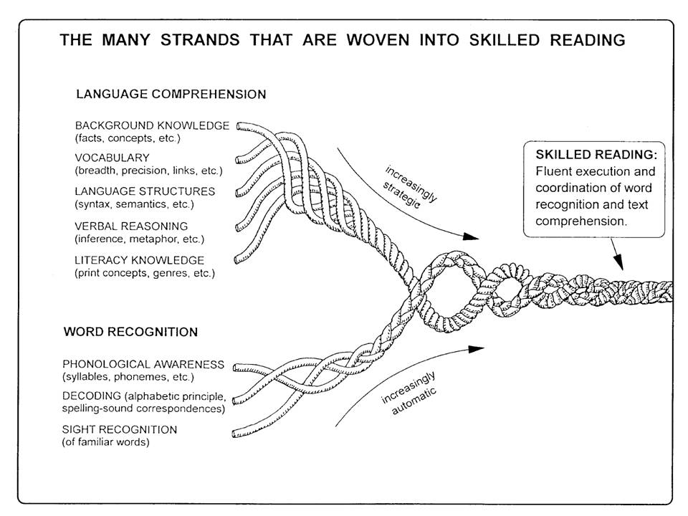
The Many Strands That Are Woven Into Skilled Reading

Slide 12
Word Recognition Strand
Word Recognition is phonological awareness, phonics, and sight recognition.
Phonological awareness refers to oral language: letters make sounds, sounds are manipulated to form words. The individual sound each letter or speech sound is called a phoneme.
Phonics refers to print: the ability to break words into smaller parts. Specifically, this is the skill of associating phonemes (single speech sounds) with letters or graphemes (the written unit corresponding to a phoneme, such as a single letter or a combination of letters).
Sight Recognition refers to knowing a word by sight rather than needing to decode it. Sight words are those words used so frequently in text that the reader needs to be able to recognize it by sight (a, and, the, etc.)
Reading Fluency: skilled readers must be able to use those decoding skills to be able to read fluently (speed, accuracy) and with expression (prosody, intonation).

Slide 13
Language Comprehension Strand
Even when a reader becomes fluent, if the language comprehension piece is missing, the fluent reader will not comprehend what is being read. It is simply a bunch of words on a page with no meaning or deeper understanding.
Language comprehension is made up of five interrelated components:
  Background knowledge: facts, concepts, experiences
  Vocabulary: academic, non-academic, word meanings, word relationships
  Language structures: syntax, semantics, Latin roots and Greek combining forms.
  Verbal reasoning: inference, figurative language, problem solving using words.
  Literacy knowledge: understanding print concepts, genres, titles, sub-titles, headings, parts of a book, etc.
  Connecting Early Language and Literacy to Later Reading (Dis)abilities: Evidence, Theory, and Practice, H. Scarborough, in S. Neuman & D. Dickinson (Eds.), Handbook for Research in Early Literacy (pp. 97–110).

Slide 14
Reading Comprehension Strand
Think of reading comprehension as an equation:
  Phonemic Awareness + Phonics (word recognition and fluency) + Language Comprehension = Reading Comprehension
  If there are any variables missing in this equation, you will not be a skilled reader.
Learning to read involves visual and language systems, sound, processing speed, working memory, and attention.
Reading is a multisensory affair, and each region of the brain plays a role.

Slide 15
Impediments to Skilled Reading
Students who do not become proficient or skilled readers struggle to access their grade level standards, curriculum and instruction.
Students do not become proficient readers for a plethora of reasons:
  Poverty
  ELL
  Disability
  Educational neglect
Despite the impediments, most students have the ability to learn to read proficiently.
For students with disabilities, the curriculum and instructional modalities must be addressed by the IEP/504 team.

Slide 16
Curriculum and Instruction
The child's IEP must include “a statement of the special education and related services and supplementary aids and services, based on peer‐reviewed research to the extent practicable to be provided to the child.” (Section 1414(d)((1)(A)(i)(IV)).
An overriding theme of the IDEA is that it requires the use of "scientifically based instructional practices." Peer-reviewed research is one such practice.
Ultimately, the IEP team has the final say about what curriculum and instructional modalities will be required to provide the student with FAPE, but IDEA is clear that whatever is used must be peer-reviewed as effective for this population “to the extent practicable.”

Slide 17
PEER-REVIEWED RESEARCH
Peer-reviewed research is "research that is reviewed by qualified and independent reviewers to ensure that the quality of the information meets the standards of the field before the research is published." 71 Fed. Reg. 46,664 (2006).
Reducing the term to a single definition is difficult because the review process varies depending on the type of information to be reviewed. 71 Fed. Reg. 46,664 (2006).
Peer-reviewed research generally refers to research that is reviewed by qualified and independent reviewers to ensure that the quality of the information meets standards of the field before the research is published. Determining whether a particular early intervention service is based on peer-reviewed research may require a review of literature or other information that reports on the use of evidence-based practices by peer providers. Letter to Kane, 55 IDELR 203 (OSEP 2010).

Slide 18
“To the extent practicable”
The phrase "to the extent practicable," as used in IDEA, generally means that services and supports should be based on peer-reviewed research to the extent that it is possible, given the availability of peer-reviewed research. 71 Fed. Reg. 46,665 (2006).
Take away:
  If it isn’t practicable, District can use something else.
  The peer-reviewed studies do not necessarily have to show the services or supports were peer reviewed as effective for the population of students with the child's unique combination of disabilities.
  Ultimately, the program must be sufficient to show it provides the student with FAPE.

Slide 19
Where Can you Find Peer-Reviewed Research?
What Works Clearing House: While this database is a bit clunky and sometimes hard to use, it is my go-to for research and peer reviewed studies in the field of education.
  https://ies.ed.gov/ncee/wwc/FWW/Results?filters=,Literacy
Student Achievement Partners: SAP is a nonprofit dedicated to improving literacy and mathematics outcomes for K-12 students nationally.
  https://achievethecore.org/about-us
Academics Interventions Tool Chart: Six tool charts intended to assist educators and families in becoming informed consumers who can select academic and behavioral assessment tools and interventions.
  http://www.intensiveintervention.org/resources/tools-charts

Slide 20
Three Types of Reading Disabilities
There are three types of developmental reading disabilities:
  Phonological deficit, implicating a core problem in the phonological processing system of oral language.
  Processing speed/orthographic processing deficit, affecting speed and accuracy of printed word recognition (RAN or fluency problem).
    Orthographic processing is the ability to visually recognize and remember written words and parts of words. It includes the ability to immediately recognize letter sequences, patterns, symbols, and to spell phonetically irregular words.
  Comprehension deficit, specifically found in children with social-linguistic disabilities (e.g., autism spectrum), vocabulary weaknesses, generalized language learning disorders, and learning difficulties that affect abstract reasoning and logical thinking.

Slide 21
What Works
Finding what works for students is an individualized approach. However, there are some universal best practices that have been long recognized as effective for struggling readers:
  Direct, explicit, multisensory instruction
  Curriculum that is systematic, has built in progress monitoring, is differentiated, and covers all five foundational reading skills in the proper scope and sequence:
    Phonemic awareness, phonics, fluency, vocabulary, and comprehension.
  Identifying which type of reading disability the student has and tailoring the goals and objectives to their specific needs.

Slide 22
Evaluations
In order to determine what the student’s strengths and weaknesses are, evaluations are necessary.
Understanding what type of data you need to capture in order to make informed decisions is vital.
Remember, students with developmental reading disabilities often have co-occurring issues that affect their ability to access their curriculum and instruction, retain the information they have learned, and retrieve the information when necessary.
Make sure you are evaluating for all these issues as well.

Slide 23
Co-occurring Issues: SLP
The following skill areas should be assessed by a speech-language pathologist:
  Speech Sound Errors/Skills: Is the student using any phonological processes in his speech?
  Phonological Awareness Skills: How does the student do with phonological awareness tasks like rhyming, segmenting, blending, etc.?
  Overall Language Skills: How does the student score on expressive and receptive language tests?

Slide 24
Co-occurring Issues: OT (1 of 2)
The following skills may need to be assessed by an Occupational Therapist:
Oculomotor function or visual efficiency
  Visual Perception Skills Development
    Visual discrimination to improve a child’s ability to classify objects based on color, forms, shapes, and other attributes.
    Visual memory to improve the ability to recall information, such as shapes, patterns, the sequence of events once it has been removed from sight.
    Spatial awareness to teach how an object is placed in relation to oneself in space. Students with poor visual perceptional skills often observed making clumsy movements and often bumping into things.
    Eye-Hand coordination is a vital skill required for reading and handwriting.
  Motor coordination
Handwriting Skills Development

Slide 25
Co-occurring Issues: OT (2 of 2)
Executive functioning
  Organizational Skills Development
  Teaching how to think in reverse to find a solution to a task.
  Breaking a large task into smaller ones. Not only it becomes more manageable, but it also reduces anxiety.
  Teaching how to prepare physically and mentally for a task in advance. A visual timetable for the week is perfect for planning ahead. Planning early reduces anxiety and last moment time pressure and helps in achieving better results in the task.
  Using visual cues for recalling work to be done. ‘To-Do’ lists are helpful in keeping track.

Slide 26
Academic Assessment Areas
Phonological Awareness – an individual’s awareness of and access to the sound structure of his/her oral language
Phonological or Language-Based Memory – ability to recall sounds, syllables, words
Rapid Automatic Naming – speed of naming objects, colors, digits, or letters
Receptive Vocabulary – understanding of words heard
Phonics Skills – understanding of the symbol (letter) to the sound(s) relationship, either individually or in combination with other letters
Decoding –ability to use symbol-sound associations to identify (read – pronounce) words
Oral Reading Fluency – ability to read accurately, at a story-telling pace – to facilitate / support comprehension
  Sentences and Paragraphs
Spelling
Writing
  Sentence Level and Paragraph Level

Slide 27
Contact
Disabilities Rights Florida
800-342-0823
www.disabilityrightsflorida.org/intake

